Slide 1
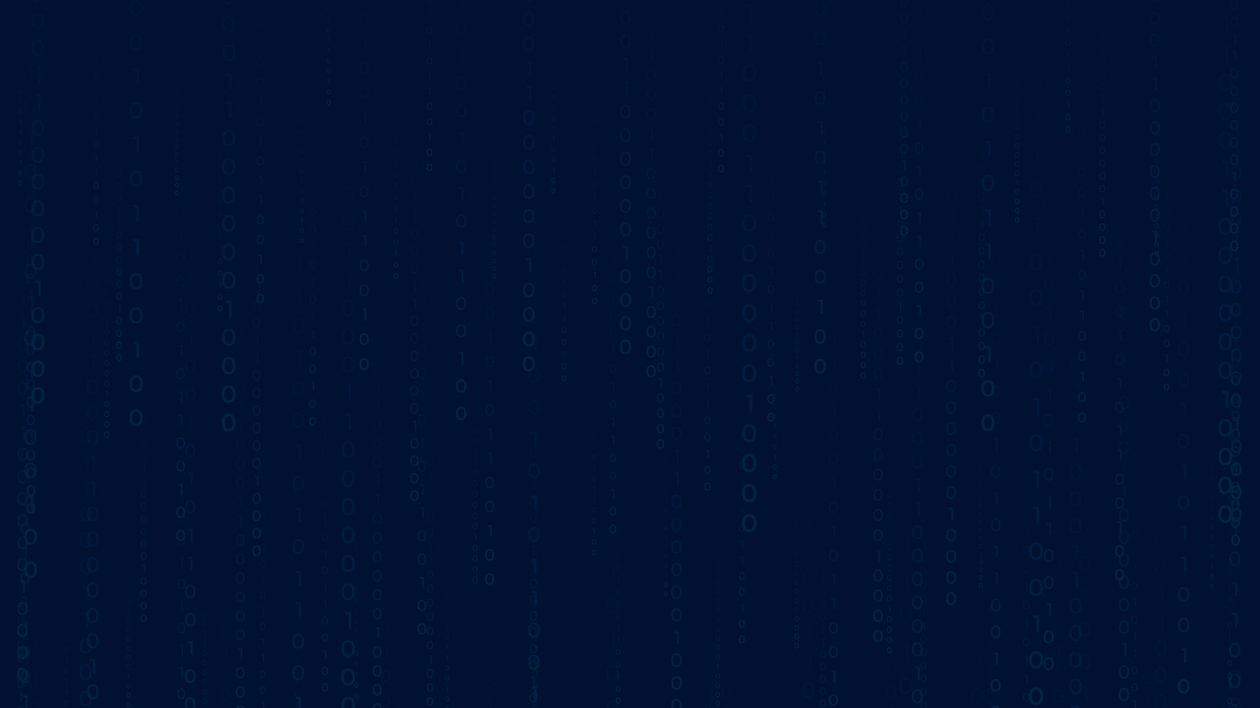




Next Word Prediction using Pretrained Models
Team : H.R.Murali Mohan (h.ramappa.gari.muralimohan@gmail.com) P.Naga pavan kumar ( ppkumar25466@gmail.com)
Guide:Mr.Abdul Aziz Md sir
Disclaimer: The content is curated for educational purposes only.
Notes:
Slides: Prepare a short slide deck (10-12 slides) summarizing the project objectives, methodology, and key results.

Slide 2
:Next Word Prediction using Pretrained Models
OUTLINE
Abstract of the Project
Problem Statement
Proposed Solution
System Architecture
Live Demo of the Project
Embedded Video of Project
Conclusion
Future Scope

Slide 3
Abstract
:Next Word Prediction using Pretrained Models
This project builds a Next Word Prediction app using advanced Natural Language Processing (NLP) models. The app allows users to type a sentence and get predictions for the next word using pretrained models like BERT, RoBERTa, DistilBERT, and GPT-2. Users can choose which model to use and adjust how many predictions they want to see. The app works in real-time, providing suggestions based on the input text.
The app uses Streamlit for its user interface and integrates these powerful models to generate predictions efficiently. This project showcases how AI models can be used in real-world applications like autocomplete and intelligent text prediction systems.

Slide 4
Problem Statement
:Next Word Prediction using Pretrained Models
Text prediction systems are commonly used in apps like messaging or search engines, but they often don’t understand the context well. The goal of this project is to build a smart text prediction tool using advanced models like BERT, RoBERTa, and GPT-2. These models can predict the next word in a sentence based on what the user has typed, making the prediction more accurate and context-aware. The challenge is to create an easy-to-use app that provides useful word suggestions while understanding the input better than traditional systems.

Slide 5
Proposed Solution
:Next Word Prediction using Pretrained Models
We will create a text prediction system using advanced AI models like BERT, RoBERTa, and GPT-2. These models are designed to understand and predict language, making them ideal for this task.
AI Model Selection:
We'll use powerful AI models like BERT, RoBERTa, and GPT-2, which are trained to understand the context of language and generate predictions based on it.
User Interaction:
The system will allow users to type a sentence. The AI will predict the next word or phrase, helping users finish their thoughts or complete sentences.
Prediction Accuracy:
The models will generate a list of possible next words based on the context of the input. Users can select how many predictions they want.
Easy-to-Use Interface:
A user-friendly interface will be provided where users can simply type their text and view predictions.
Testing and Improvement:
We will evaluate the accuracy of predictions to ensure the system provides meaningful and relevant results.

Slide 6
System Architecture
:Next Word Prediction using Pretrained Models
The System Architecture for the Next Word Prediction project involves three main components: Frontend, Backend, and AI Model Integration.
Frontend (User Interface):
The Streamlit framework is used to create a web-based interface for the users.
Users enter a sentence (with placeholders like <mask>) and select the number of predictions they want.
A sidebar allows users to choose different models (BERT, RoBERTa, GPT-2) for word prediction.
Backend:
Model Loading: The backend is responsible for loading and serving the machine learning models (BERT, RoBERTa, GPT-2).
Prediction Process: The backend takes the user input, processes it, and sends it to the selected model for prediction.
AI Model Integration:
BERT: A transformer-based model used for masked language modeling.
RoBERTa: An optimized version of BERT for better performance.
GPT-2: A generative model capable of predicting the next sequence of words.
Deployment:
The app is deployed on a web platform (local or cloud) using Streamlit, providing real-time word predictions.
This architecture allows for accurate, context-aware word predictions in an interactive environment.

Slide 7
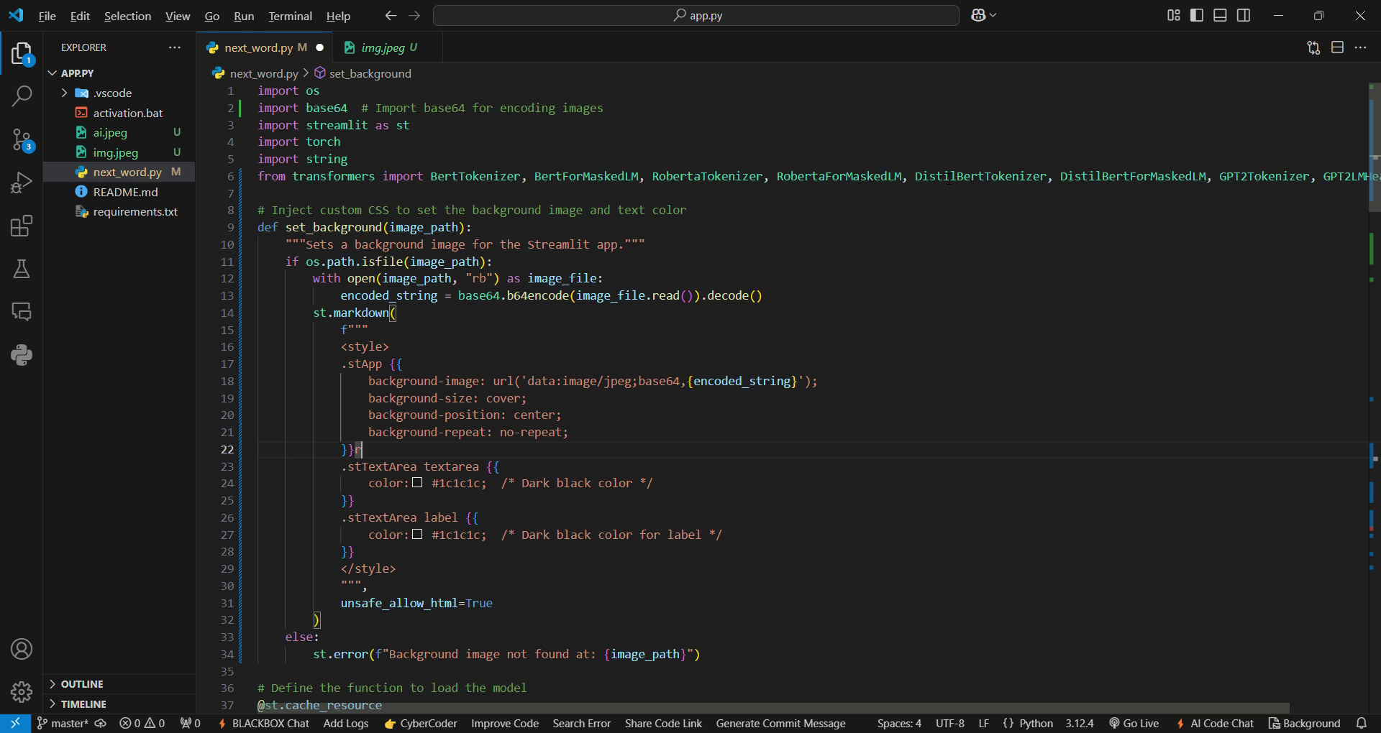
:Next Word Prediction using Pretrained Models
Video of Project Demo

Slide 8
Conclusion
:Next Word Prediction using Pretrained Models
This project demonstrates the practical use of transformer models in real-time word prediction, providing a useful tool for enhancing writing, communication, and content generation. It serves as a foundational step towards more advanced NLP applications, with the potential for further customization and improvements in the future.
The application is developed with Streamlit, providing a simple, interactive interface where users can select a model, input a sentence, and receive word predictions. The core process involves encoding the input, generating predictions from the selected model, and decoding them into readable text.
By integrating multiple models, the project offers flexibility, allowing users to choose the model that best fits their needs. It highlights how these powerful NLP models can be used in practical, real-world applications, enhancing language-based tasks.

Slide 9
Future Scope
:Next Word Prediction using Pretrained Models
The future scope of this project lies in several areas of enhancement and expansion, leveraging the power of natural language processing (NLP) and machine learning models. Some key areas for future improvement include:
Integration of More Models: Future versions could support a wider range of models like GPT-3, T5, or BART, each with unique strengths, to provide more varied and accurate predictions.
Context-Aware Predictions: Enhancing the models to better handle complex, long-term dependencies within sentences, making predictions more contextually aware and coherent across multiple sentences.
Multi-language Support: The system could be expanded to support multiple languages, enabling users worldwide to benefit from next-word prediction, enhancing accessibility.
Real-Time Collaborative Features: The app could be upgraded to include real-time collaboration, where multiple users can input text simultaneously and receive suggestions or improvements in a shared workspace.
User Feedback Integration: Implementing a feedback loop to refine model predictions based on user corrections and preferences.

Slide 10
:Next Word Prediction using Pretrained Models
Thank you!
Notes:
thank you very much for joining this PPT, keep learning.

